Slide 1

Technology PPT
Presented By
Shreyang Solanki

Slide 2




Agenda
1) Talk about software Testing
2) Current and upcoming Trends
3) Technology skill upgradation
4) Career Aspiration
5) Learning Growth
6) Learning at tops Technologies
7) Why am I selected this field

Slide 3
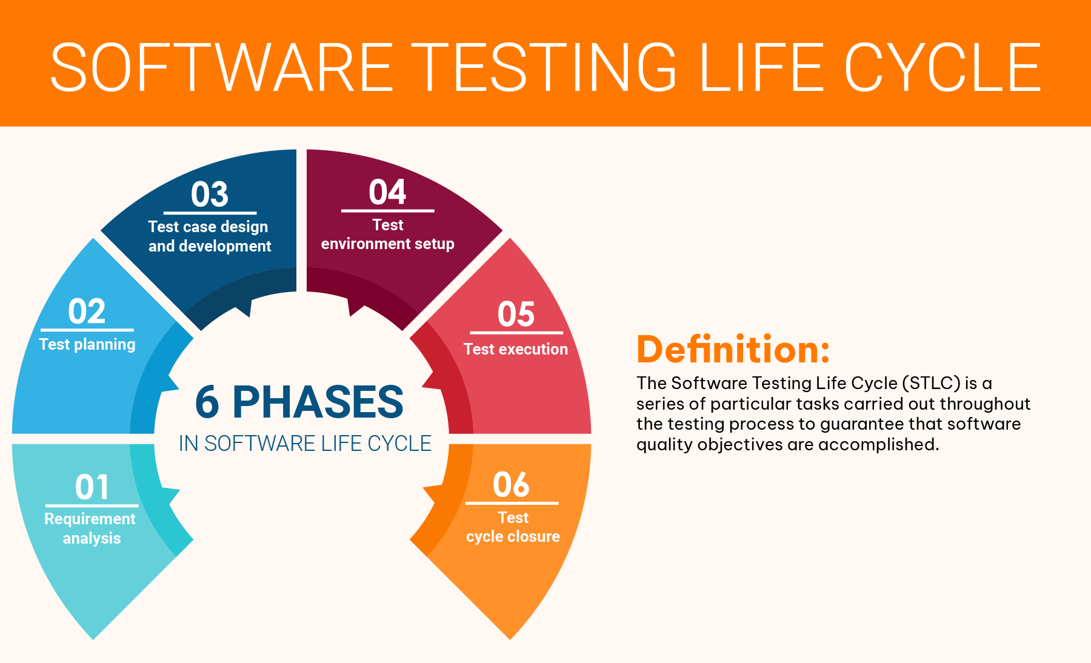
Talk About Software Testing
Software Testing Is The Process Of Evaluating And Verifying That A Software Product Or Application Does What It's Supposed To Do. The Benefits Of Good Testing Include Preventing Bugs And Improving Performance

Slide 4
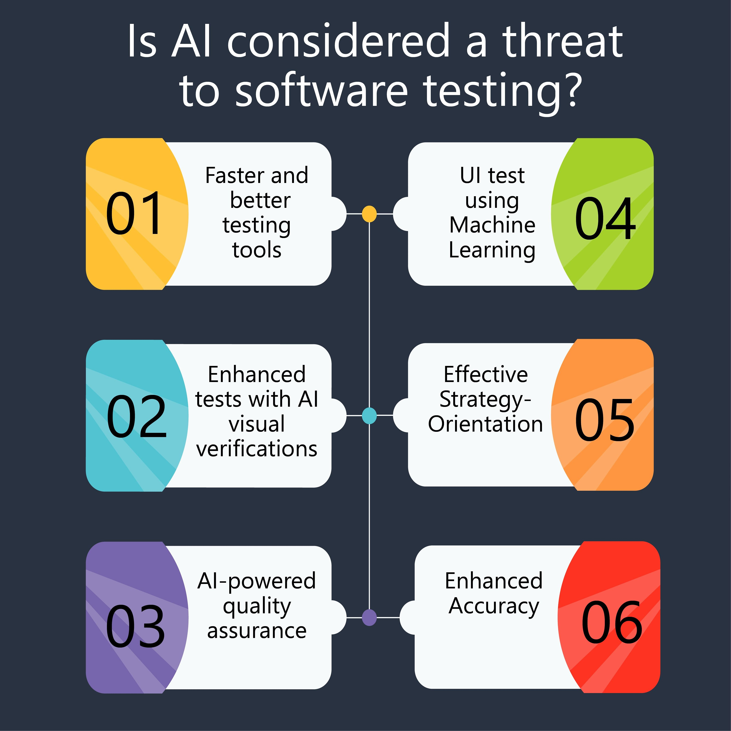


Current And Upcoming Trends
AI In Testing
Blockchain Technology
Internet of things
Today Is Evolving At A Rapid Pace, Enabling Faster Change And Progress Technology Causing An Acceleration Of The Rate Of Change. However, It Is Not Only Technology Trends And Emerging Technologies That Are Evolving, A Lot More Has Changed, Making IT Professionals Realize That Their Role Will Not Stay The Same In The Contactless Old Tomorrow. And An IT Professional In 2024 Will Constantly Be Learning, Unlearning, And Relearning (Out Of Necessity, If Not Desire).

Slide 5
Career Aspiration
Career Aspirations Are Long-term Hopes And Ambitions. People Develop Them Based On Their Personal Experiences, Including Talents, Values, Lifestyle, And More. Examples Of Career Aspirations Might Include: Working In An Industry That You're Passionate About.

Slide 6

Learning Growth
>Tops Technology ( Maninagar )
Take online courses or tutorials: There are many free and paid online resources that can help you learn about specific technologies or software. Websites like Coursera, Udemy, and Khan Academy offer a wide range of courses on various tech topics.
>Practice regularly: The best way to improve your tech skills is to use them regularly. Whether it's coding, graphic design, or using specific software, the more you practice, the better you'll become.
>Stay updated: Technology is constantly evolving, so it's important to stay updated on the latest trends and developments. Follow tech news websites, blogs, and social media accounts to stay informed.
>Join tech communities: Joining online forums, social media groups, or local tech meetups can provide you with a supportive community where you can ask questions, share knowledge, and learn from others.

Slide 7
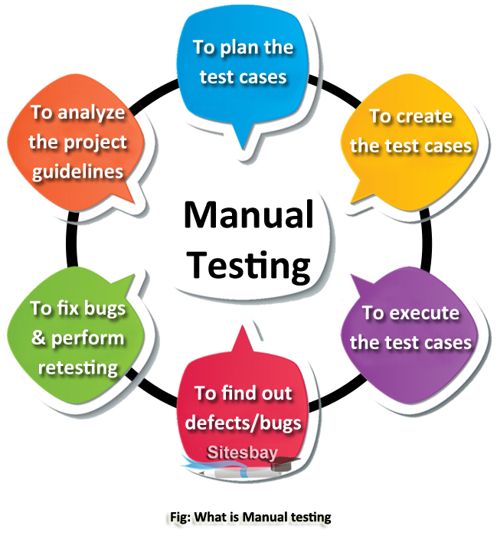
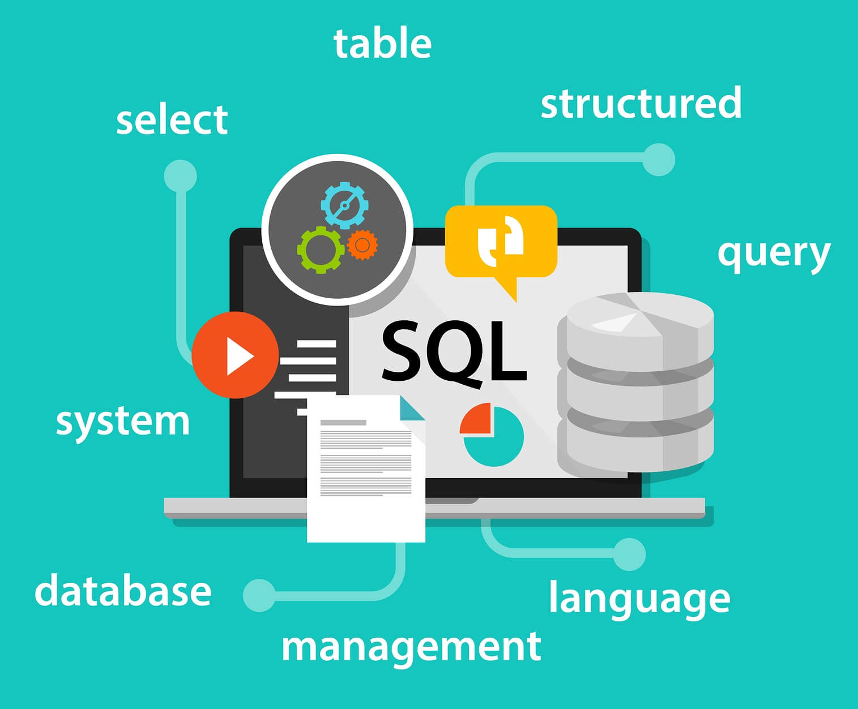
Learning At Top Technology
Manual Testing
SQL

Slide 8
Why I am selected this field
I Am Passionate About The Testing Field As I Would Always Like To Make Things Better And Improve Their Quality. This Field Provides Me With This Opportunity In Testing And As A Software Tester, I Have An Opportunity To Contribute To The Quality Of The Product.
Tops Technologies Is The Best It Training, Software Development, And Placement Co. In Gujarat. Over 100000 Students Trained And Placed At 3000+ IT Partner ...

Slide 9

Thank you
Shreyang Solanki

